Slide 1
Object Oriented Programming Design
Presented by
Dr Ramya Devi M
mramyadevi@wilp.bits-pilani.ac.in
CS - 03 : 12th Jul 2025

Slide 2
Looping Structure and Unconditional branching

Slide 3
Learning Objectives
Various types of looping structure
Unconditional branching
Object Oriented Programming , Lecture 3

Slide 4




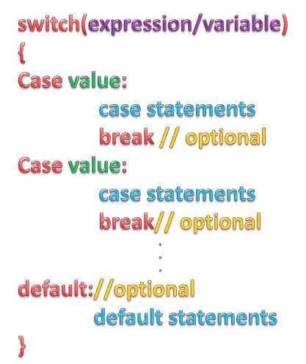
A switch statement is used to test many conditions
Syntax:

Slide 5







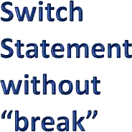











Flow Chart:
Start
Variable or Expression
Case A
Case A Statements
True
False
Case B
Case B Statements
True
False
…
Case C Statements
True
False
default
Default Statements
End

Slide 6






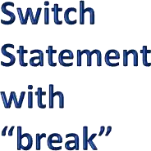













Flow Chart:
Start
Variable or Expression
Case A
Case A Statements break;
True
False
Case B
Case B Statements break;
True
False
…
Case C Statements break;
True
False
default
Default Statements
End

Slide 7
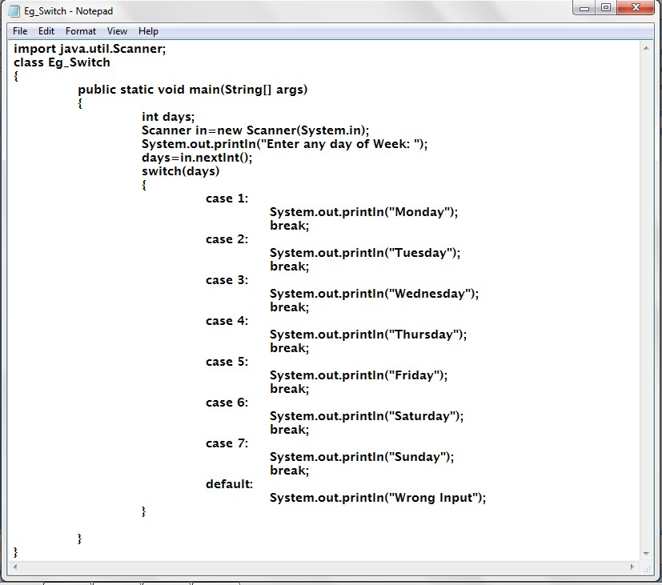

Example:

Slide 8






-Initialization
-Condition checking
-Execution
-Increment / Decrement

Slide 9
Entry Controlled | Exit Controlled
Condition is checked at the entry of the loop | Condition is checked at the exit of the loop
If condition is initially false, the loop never executes | If condition is initially false, then also the loop executes at least once
i=1; while(i==0) { System.out.println(“In While loop”); } System.out.println(“out of the loop”); | i=1; do { System.out.println(“In While loop”); } while(i==0); System.out.println(“out of the loop”);
Output: Out of the loop | Output: In while loop Out of the loop
Example- for, while | Example – do-while

Slide 10
Looping Structure - while
It is a structure in which a block is to be executed more than once.
This structure is also called as the Looping structure or
Iterative structure .
The block may be a single statement or a collection of more than one statements begins with { and ends with }.
There are three types of repetitive structures. They are
While Loop (ii) Do .. while Loop (iii) For
(i) The While Loop : In this structure the block specified for the while loop is executed only if the condition is false. The general format of the while Loop is
while ( condition ) block;
where the condition may be a relational or logical expression.
When the while loop is executed , it first checks the condition.

Slide 11
While loop
Case (i) : if the condition is true, the block is executed. After the block is executed , the control returns to the condition again and checks whether the condition is true now. If so, the block is executed again. The process is repeated as long as the condition is true.
Case (ii): if the condition is false, the control is transferred to the next statement of while loop.
The minimum number of iteration ( ie.,, when the condition is false ) of executing the block for while loop is 0.

Slide 12
While loop
Examples:
1. i=1;
while ( i <= 10 )
{
System.out.println(“ “+i);
i = i + 2;
}
System.out.println(“ OK..”);
the output of the above segment is
1
3
5
7
9
OK..

Slide 13
While loop
2. i=11;
while ( i <= 10 )
{
System.out.println(“ ”+i);
i = i + 2;
}
System.out.println(“ OK..”);
the output of the above segment is
OK..
In the second example, the block is not executed because the condition is false and the control does not enter into the block.

Slide 14



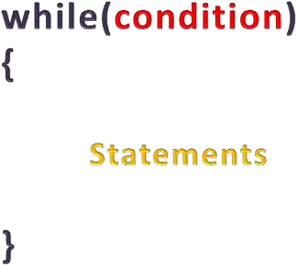






Slide 15
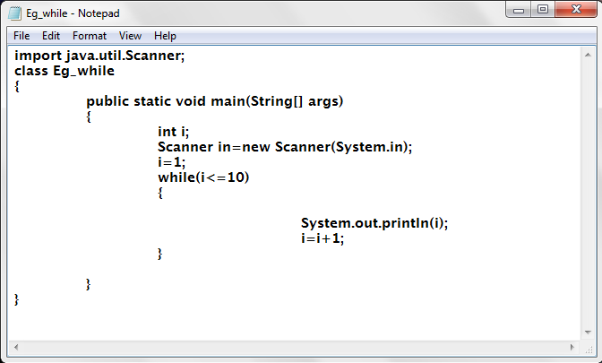

Slide 16
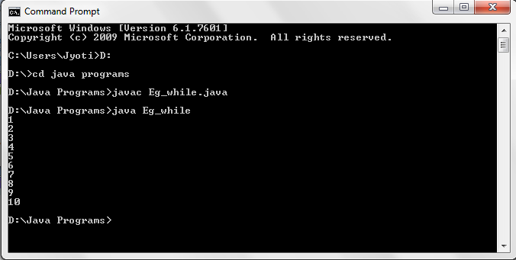

Slide 17


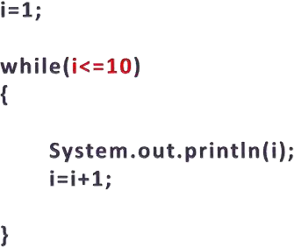
Initialization Statement is used to initialize a variable/ counter.

Slide 18

The condition statement controls the execution of loop
The loop executes till the condition statement is true

Slide 19
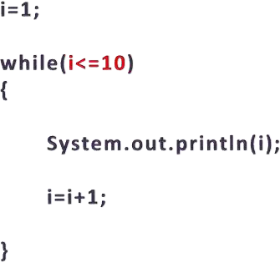
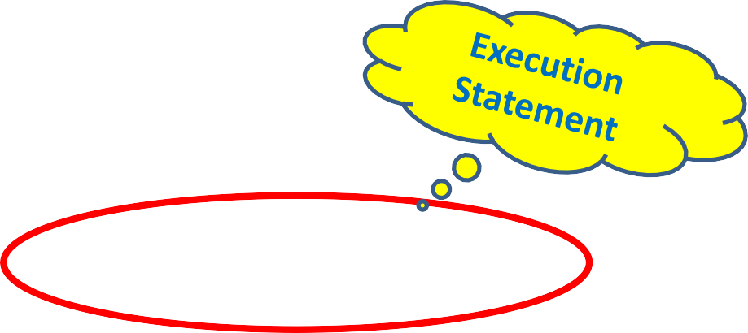
The execution statements are the main body of a loop
All action statements of loop are written here

Slide 20


This section increment or
is used to
decrement
the variable value

Slide 21

Output
i
Variable i in memory
1

Slide 22


Condition is True
Output
i
Variable i in memory
1

Slide 23


Check it
out here
Output
i
Variable i in memory
1
1

Slide 24


Check it out here
Output
2
1
i
Variable i in memory

Slide 25

Condition is checked again
Output
i
Variable i in memory
1
2

Slide 26
Condition is True
Output
i
Variable i in memory
1
2

Slide 27
Check it
out here
Output
i
Variable i in memory
1
2
2

Slide 28
Check it out here
Output
3
1
2
i
Variable i in memory

Slide 29
Condition is checked again
Output
i
Variable i in memory
1
2
3

Slide 30
Condition is True
Output
i
Variable i in memory
1
2
3

Slide 31
Check it
out here
Output
i
Variable i in memory
1
2
3
3

Slide 32
Check it out here
Output
4
1
2
3
i
Variable i in memory

Slide 33
Condition is checked again
Output
i
Variable i in memory
1
2
3
4

Slide 34
Condition is True
Output
i
Variable i in memory
1
2
3
4

Slide 35
Check it
out here
Output
i
Variable i in memory
1
2
3
4
4

Slide 36
Check it out here
Output
5
1
2
3
4
i
Variable i in memory

Slide 37
Condition is checked again
Output
i
Variable i in memory
1
2
3
4
5

Slide 38
This process will continue till the condition become false
Suppose value of i is 9 now

Slide 39
Output
Condition is True
i
Variable i in memory
1
2
3
4
5
6
7
8
9

Slide 40
Check it
out here
Output
i
Variable i in memory
1
2
3
4
5
6
7
8
9
9

Slide 41
Check it out here
Output
10
1
2
3
4
5
6
7
8
9
i
Variable i in memory

Slide 42
Output
Condition is checked again
i
Variable i in memory
1
2
3
4
5
6
7
8
9
10

Slide 43
Output
Condition is Still True
i
Variable i in memory
1
2
3
4
5
6
7
8
9
10

Slide 44
Check it
out here
Output
i
Variable i in memory
1
2
3
4
5
6
7
8
9
10
10

Slide 45
Check it out here
Output
11
1
2
3
4
5
6
7
8
9
10
i
Variable i in memory

Slide 46
Output
Condition is checked again
i
Variable i in memory
1
2
3
4
5
6
7
8
9
10
11

Slide 47
Output
Condition is FALSE
i
Variable i in memory
1
2
3
4
5
6
7
8
9
10
11

Slide 48



Output
11
1
2
3
4
5
6
7
8
9
10
i
Variable i in memory
Skip the body of the lop and executes the statement just after the loop

Slide 49


Final value of i after the complete loop
Output
1
2
3
4
5
6
7
8
9
10
11
i
Variable i in memory

Slide 50


Output
Final output of the loop
11
1
2
3
4
5
6
7
8
9
10
i
Variable i in memory

Slide 51
The for loop
} while ( i <= 10 );
System.out.println(“ OK..”);
The output of the above segment is
11
OK..
In the second example, the block is executed once because
The condition is false and the control does not enter into the
block.
(iii)The for loop: When this loop is executed , the condition is
checked for each iteration. The for loop has the following
format
for ( initialization part ; conditional part ; incremental / decremental part) block;

Slide 52
The for loop
When the FOR loop is executed , the following steps are
done.
Step 1: Initialization part is performed first
Step 2: The condition is verified.
Step 3: If the condition is True ,
  Block is executed
  The incremental or decremental part is done
  Again , the control goes to step (2)
If the condition is False ,
The control goes to the statement which lies after the For loop without executing the block.

Slide 53
The for loop
Examples:
for ( i =1 ; i<=8 ; i++)System.out.println(“ ”+i); System.out.println(“\n OK..”);
The output of the above segment is
1
2
3
4
5
6
7
8
OK..

Slide 54
The for loop
for ( i =10 ; i<=8 ; i++)System.out.println(“%d\n”,i);
System.out.println(“\n OK..”);
The output of the above segment is
OK..

Slide 55


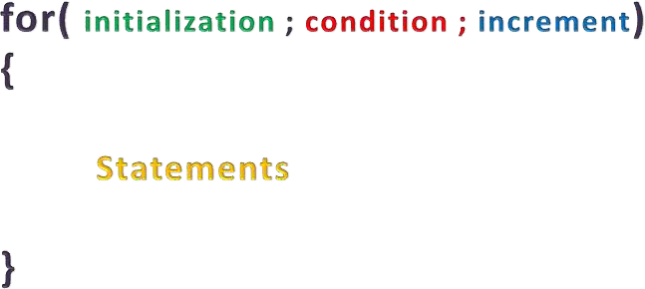





Slide 56

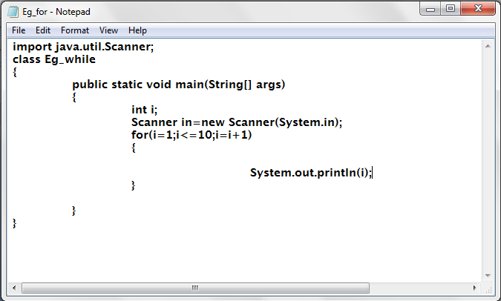

Slide 57
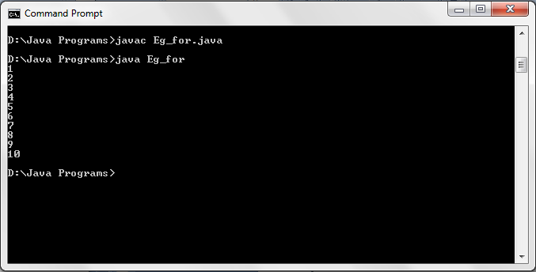

Slide 58
Do-While loop
(ii)The Do .. While loop: When this loop is executed , the condition is checked after the block is executed once. The general format of the do .. while Loop is
do
{
block;
}while ( condition ) ;
where the condition may be a relational or logical expression.
When the do .. while loop is executed , it executes the block
once and then the condition is checked.
Case (i) : if the condition is true, the block is executed again.
After the block is executed , it again checks the condition
whether it is true. The process is repeated as long as the

Slide 59
Do-While loop
condition is true.
Case (ii): if the condition is false, after the execution of block
once, the control is transferred to the next statement of while
loop.
The minimum number of iteration ( ie., though the condition is
false ) of executing the block for while loop is 1.
Examples:
1. i=1;
do
{
System.out.println(“ ”+i);
i = i + 2;
} while ( i <= 10 );

Slide 60
Do-While loop
System.out.println(“OK..”);
The output of the above segment is
1
3
5
7
9
OK..
2.
i=11;
do { System.out.println(“ ”+i);
i = i + 2;

Slide 61

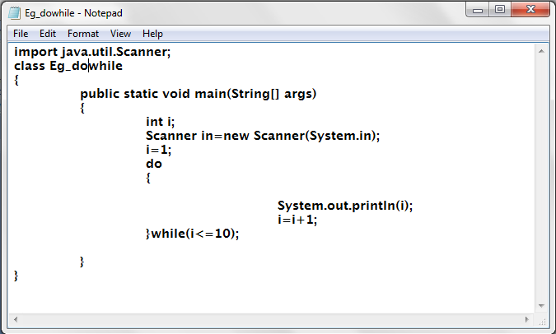

Slide 62
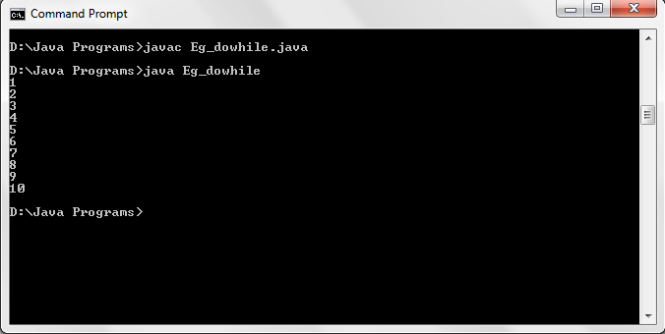

Slide 63
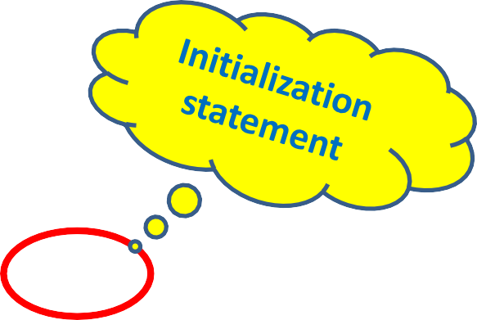
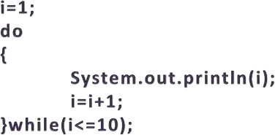
Initialization Statement is used to initialize a variable/ counter.

Slide 64
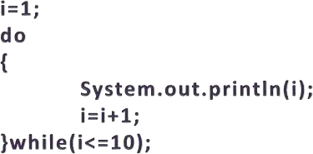

The condition statement controls the execution of loop
The loop executes till the condition statement is true

Slide 65
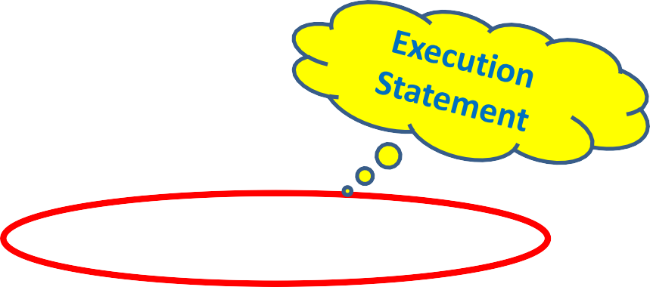
The execution statements are the main body of a loop
All action statements of loop are written here

Slide 66

This section increment or
is used to
decrement
the variable value

Slide 67
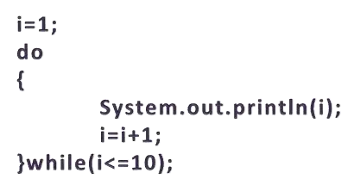
Output
1
i
Variable i in memory

Slide 68



No condition checking at entry of the loop
Output
i
Variable i in memory
1

Slide 69

Check it
out here
Output
i
Variable i in memory
1
1

Slide 70

Check it out here
Output
2
1
i
Variable i in memory

Slide 71

Output
i
Variable i in memory
1
2
Condition is checked again

Slide 72


Output
i
Variable i in memory
1
2
Condition is True

Slide 73

Check it
out here
Output
i
Variable i in memory
1
2
2

Slide 74
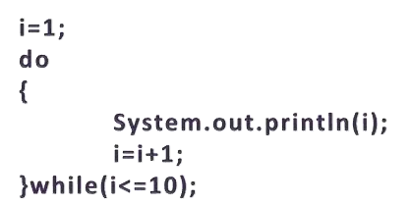
Check it out here
Output
3
1
2
i
Variable i in memory

Slide 75

Output
i
Variable i in memory
1
2
3
Condition is checked again

Slide 76

Output
i
Variable i in memory
1
2
3
Condition is True

Slide 77
Check it
out here
Output
i
Variable i in memory
1
2
3
3

Slide 78
Check it out here
Output
4
1
2
3
i
Variable i in memory

Slide 79
Output
i
Variable i in memory
1
2
3
4
Condition is checked again

Slide 80


Output
i
Variable i in memory
1
2
3
4
Condition is True

Slide 81
Check it
out here
Output
i
Variable i in memory
1
2
3
4
4

Slide 82
Check it out here
Output
5
1
2
3
4
i
Variable i in memory

Slide 83
Output
i
Variable i in memory
1
2
3
4
5
Condition is checked again

Slide 84
This process will continue till the condition become false
Suppose value of i is 9 now

Slide 85


Output
i
Variable i in memory
1
2
3
4
5
6
7
8
9
Condition is True

Slide 86
Check it
out here
Output
i
Variable i in memory
1
2
3
4
5
6
7
8
9
9

Slide 87
Check it out here
Output
10
1
2
3
4
5
6
7
8
9
i
Variable i in memory

Slide 88

Output
i
Variable i in memory
1
2
3
4
5
6
7
8
9
10
Condition is checked again

Slide 89
Output
i
Variable i in memory
1
2
3
4
5
6
7
8
9
10
Condition is Still True

Slide 90
Check it
out here
Output
i
Variable i in memory
1
2
3
4
5
6
7
8
9
10
10

Slide 91
Check it out here
Output
11
1
2
3
4
5
6
7
8
9
10
i
Variable i in memory

Slide 92
Output
Condition is checked again
i
Variable i in memory
1
2
3
4
5
6
7
8
9
10
11

Slide 93


Output
i
Variable i in memory
1
2
3
4
5
6
7
8
9
10
11
Condition is FALSE

Slide 94



Output
i
Variable i in memory
1
2
3
4
5
6
7
11
Stop the
execution of the ⁸
loop and
9
10
executes the
statement just after the loop

Slide 95
Final value of i after the complete loop
Output
1
2
3
4
5
6
7
8
9
10
11
i
Variable i in memory

Slide 96
Output
Final output of the loop
11
1
2
3
4
5
6
7
8
9
10
i
Variable i in memory

Slide 97
JUMP statements in Looping Structure
Jump statement is used to alter the sequential flow of execution inside the loop.
There are four types of jump statements in java
Break
Labelled break
Continue
Labelled Continue
Return
1. Break
In java the break statement has 3 uses
Terminates a statement sequence in a switch statement
It can be used to exit loop
It is the more civilized form of goto statement

Slide 98
The break statement
Using Break to exit the loop
By using break, we can force immediate termination of a loop, when break statement is encountered inside a loop the loop is terminated and program control resumes at the next statement following the loop
public static void main(String[] y)
{
for(int i=0;i<10;i++)
{
if(i==5)
{
System.out.println("condition break");
break;
}

Slide 99
The break statement
System.out.println("the value of i is::"+i);
}
}
The output for the above program is
the value of i is::0
the value of i is::1
the value of i is::2
the value of i is::3
the value of i is::4
ii. Labelled Break
Using the break with the labels which is equivalent to goto the
syntax is shown.
Sytax
break label_name;

Slide 100
public class LabelledBreakExample {
public static void main(String[] args) {
System.out.println("Example of 'labelled break' statement:");
outerLoop:
for (int i = 1; i <= 3; i++) {
for (int j = 1; j <= 3; j++) {
if (i == 2 && j == 2) {
break outerLoop; // Breaks out of both loops when i == 2 and j == 2
}
System.out.println("i = " + i + ", j = " + j);
}
}
}
}

Slide 101
The break statement
public static void main(String[] aa)
{
first:{
second:{
third:{
System.out.println("third block");
if(true)
break second;
}
System.out.println("second block");
}
System.out.println("first block");
}
}

Slide 102
The continue statement
The output for the above code is
third block
first block
iii. Continue
A continue statement causes control to be transferred directly
to the conditional expression that controls the loop
public static void main(String[] y)
{
for(int i=0;i<5;i++)
{
if(true)
{
System.out.println("the if block");
continue;

Slide 103
The continue statement
System.out.println("the for loop");
}
}
The output for the above code is
the if block
the if block
the if block
the if block
the if block

Slide 104
The continue statement
iv. Using continue with labels
public static void main(String[] y)
{
outer:for(int i=0;i<=2;i++){
for(int j=0;j<=2;j++)
{
System.out.println("value of J is::"+j);
if(j==1)continue outer;
}
System.out.println("the value of i is::"+i);
}
}
The output for the above program is
value of J is::0
value of J is::0
value of J is::0

Slide 105
The return statement
v. Return
The return statement is used to explicitly return from a method.
That is, it causes program control to transfer back to the caller of the method.
At any time in a method the return statement can be used to cause execution to branch back to the caller of the method.
Thus, the return statement can be used to cause execution to branch back to the caller method.
Thus, the return statement immediately terminates the method in which it is executed.

Slide 106
The return statement
public static void main(String[] aa)
{
System.out.println("before return statement");
if(true)
{
return;
}
System.out.println("after return statement");
}
The output of the above program is
before return statement

Slide 107
public class ReturnExample {
public static void main(String[] args) {
System.out.println("Example of 'return' statement:");
for (int i = 1; i <= 5; i++) {
if (i == 3) {
return; // Exits the method when i equals 3
}
System.out.println("i = " + i);
}
System.out.println("This line will not be executed.");
}
}

Slide 108
Thanks

